Slide 1
Engage & Adapt
We need each other
Notes:
There is always change in the NHS, cynically nothing happens, but gradually everything gets there.
I hate form filling, but the NHS is our biggest customer, so we need them, but they need what we have to offer. Where do we meet?

Slide 2
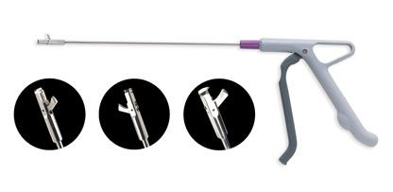
Your Single-use Solution, without compromise
Selective surgical niche markets
Swansea
2005 launch
35 employees
600 products
70% NHS customers
19 International markets
3 MediWales awards
Notes:
What we are & what we do?

Slide 3
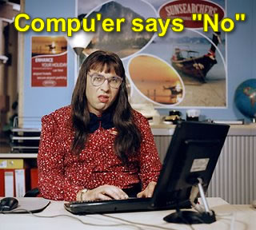
Engaging with NHS Procurement
Rigid & repetitive systems
Recognise challenges
Adhere to their requirements
Adapt to customer
Notes:
I hate forms, I often think so do the NHS Procurement!
A&E research on savings; could see 15% from wasted packs due to poor quality or unused items. Spoke to procurement who found it difficult to use outside the process
That said, we still have to meet their demands; contract provisions, sustainability, environmental, legal, insurance, indemnity etc (MIA)
However, we seek non standard niches, not prone to comonditisation as areas we awe can still help them.

Slide 4
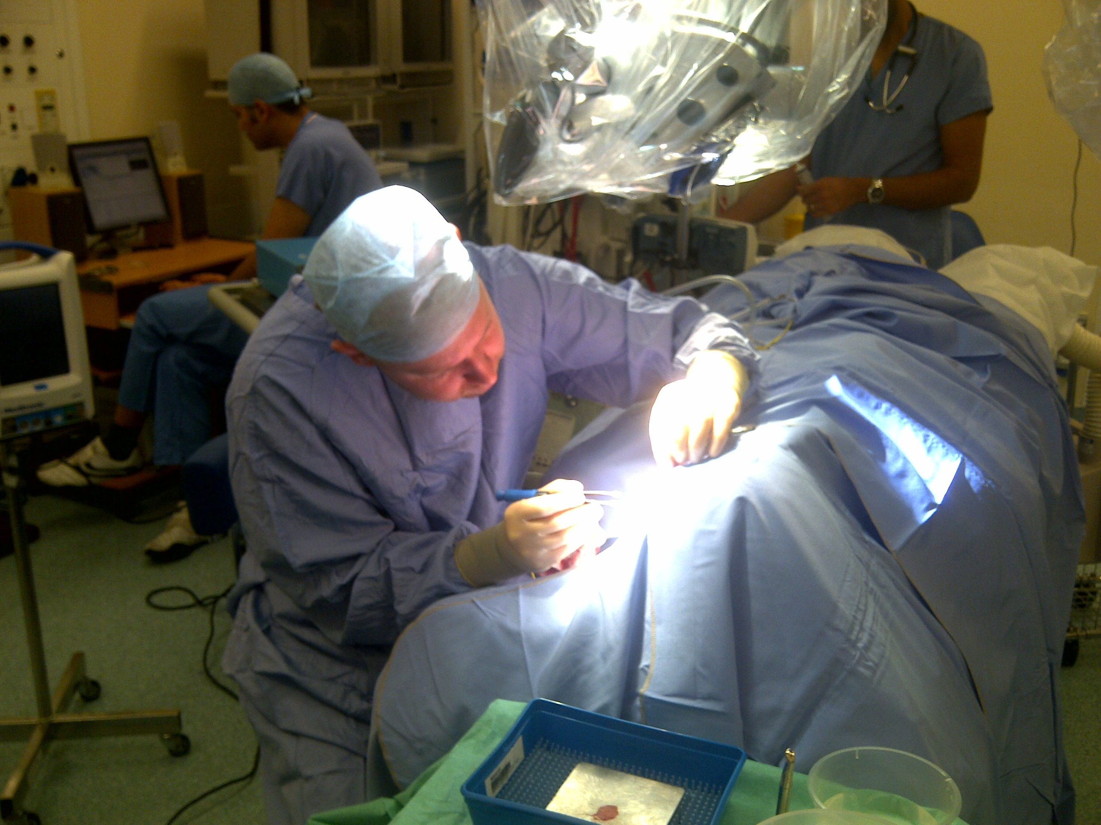
“Clinical Commissioning”
Do you do? Can you get?
Notes:
We prefer to talk to the clinicians (with permission when asked). They ask, they have strong reasons, they understand the benefits.

Slide 5
“Clinical Commissioning”
Talk to customers – 40,000 contacts p.a.
Needs satisfaction – savings, capacity, quality & safety
Make the case, calculate the benefit
Share successes
“Think like a patient, act like a taxpayer”
Simon Stevens
Notes:
Commissioning is a new term, but we have been engaging with the clinicians from the start. Knock on doors, find out what they need and fulfil it like the marketers we try to be.
Case studies help management undsrstand; they are clinical we understand commerical, production saving and capacity
Share good ideas with other customers to help them eg 15% guys ENT saving on single packs vs trays.

Slide 6
Engagement with NHS Wales
Mutual visits 2009
Welsh Price Agreement
Annual update/ new additions
Health & Wealth Good deal for Health Boards
Strong home, 3 fold growth, more jobs and local supply
Vital export base, referral & recommendation
Notes:
Mediwales years ago we met Mark and Helen James (Swansea) and got both to visit us. They saw what we do, we leanrt what theye need. EG Mark Casey comment on back order
Adapted this to our opportunity to give mutual return. Amazed others don’t seem to . (would be cautious about NHS Supply chain) In Wales, WG want both to talk and create mutual benefits – value Wales etc.

Slide 7
Engage & Adapt
We need each other
Notes:
Engaging is easy, adaptation takes time, but can create mutual benefit, outside the system can be faster, and easier to innovate at least in our niche!

