Slide 1

Category Management
Andy Smallwood
Head of Sourcing

Slide 2
Objectives
Explain the concept of Category Management
How Category Management is being used in NWSSP
Realignment of teams
A example Category
So what?

Slide 3
Definition:
Category management is a process that utilises cross functional teamwork to deliver procurement outcomes that address the needs of stakeholders.
It is not:
A different way to do a contract

Slide 4
Category Management is only part of the picture
NWSSP Business Plan
Sourcing Strategy
Category Mgt plans
Medical
Clinical
Individual KPIs & PADR

Slide 5
Suppliers
Surgeons
DoFs
HoPs
Politics
Nurses
Logistics
Legal
CSR
Patients
Staff
To do it well is not easy and may require new skills

Slide 6


Mental Health strategy and direction is akin to a Category Management approach
Ortho & Cardio strats built with approach in mind
We may not realise it, but we are already thinking differently
Food team approach is well established and has good customer engagement
Health Boards moving to CPGs
Stapling tender scope broadened to accommodate Category approach
Heads of Sourcing responsibility split

Slide 7
Proposed category split by Head of Sourcing
Non-Medial |  | Medical/Clinical
Food Catering – non food Transport Waste Pulp Stationery Postage Print Estates Domestics (cleaning) Linen & Laundry | Furniture Work wear Utilities Agency staff ID wristbands Maintenance Insurance Consultancy VAT services Legal services | Sutures & wound closure Chest & wound drainage Suction catheters & tubing Syringes & needles Gloves (Surg and exam) Instruments & Decontamination Anaesthesia & breathing Procedure packs Blood and fluid warming IV pumps and devices | Cardiology Radiology Urology collection Neurology Orthopaedics Ophthalmics Endoscopy Breast implants Drapes & gowns *Pathology & Blood * Beds and mattresses
Pharmacy & Appliances (acute and community) |  | Capital & projects
Drugs Medical gases/home oxygen Dressings and wound management Plaster room Inco Stoma care Enteral & Parental feeds IV fluids *Renal | Appliances, Audiology, Orthotics, Breast prosthesis, wigs Family planning Dental Wheelchairs Community equipment | Welsh Government initiatives Commissioning CHC/Mental Health IM&T Comms Radiology equipment (MRI, CT etc) Capital programme * Managed services (impact on product responsibilities)
This was the first stab. The real work has taken a lot longer

Slide 8

Medical/Clinical Sourcing Teams

Slide 9
Where do we start?
The breadth of the medical portfolio is vast and therefore needs to be divided into sizeable chunks to give us a fighting chance of managing the category and dealing with our suppliers and customers.
There are two high level differentiators that give us a starting point:
Medical consumable products
Clinical products

Slide 10
Getting a clearer view of the data
Oracle
Savings plans
CMS
Non-med
Med/Clin
PAD
Projects
Theatre
Consumables
Ophthalmics
Wound
closure
Cardio

Slide 11
Category levers and drivers
Which ones to use and when?
Collaboration
Market share growth
Rationalisation
Commodity tracking
Benchmarking
Clinically driven negotiation
Standardisation
Unit of purchase
Terms of business
New market entrants
Which are valid for your portfolio?
Logistics route
Innovation
Auctions
Contract type
Volume or value Commitment
Product re-engineering
Bulk deals

Slide 12


Medical categories
Products purchased and used across various Directorates

Slide 13
Medical categories
Sutures & wound closure
Chest & wound drainage
Suction catheters & tubing
Syringes & needles
Surgeons and exam gloves
Instruments
Anaesthesia & breathing
Procedure packs
Blood and fluid warming
IV pumps and devices
Grouped to reflect stakeholder groups i.e customer clusters, similar suppliers, procurement approach etc

Slide 14
Medical Team
SCM
Alex Curley
ACO
Matthew Juravcic
ACO
Rhys Jenkins
CM – Anaes, Breath, IV
Nia Harvey
Theatre
Consumables
CO Vascular
Vicky Evans
CO Theatreware
Emma Keen
CO Airways
Rhian Davies
CO Needles, Breath
Laura Perrott
CM
Diag, Gen Med
Joanne Prothero
CO Med Consumables
Band 4
CO Diagnostics
Carys Toozer
CO Diagnostics
Band 4
CO Theatre Equip
Adam Challonder

Slide 15

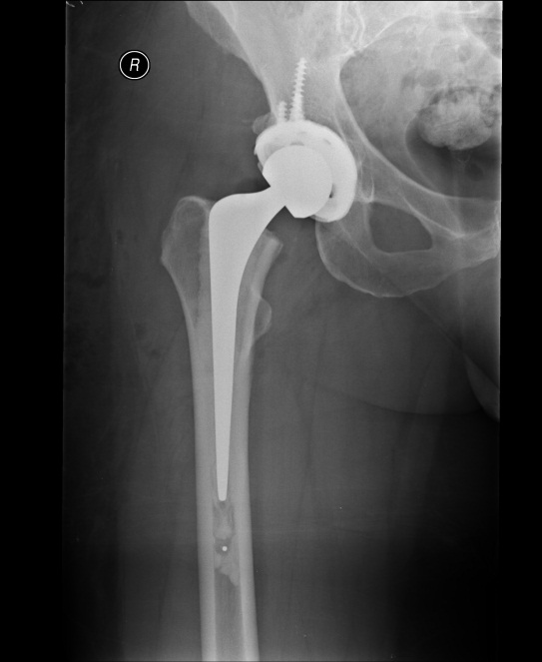
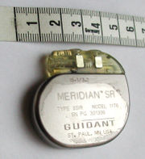
Clinical categories
Categorised as products purchased and used solely by Clinical directorates without crossover

Slide 16
Clinical categories
Orthopaedics
Cardiac (cardiology & surgery)
Radiology
Pathology
Endoscopy
Urology
Ophthalmics
Neuro

Slide 17
Clinical Team
SCM
Wyn Owens
ACO
Band 2
CM
Matt Alderman
CM
Band 6
Ortho & Cardio
CO Ophthal
Sam Brealey
CO Gen surg
Liz Ewing
CO Cardio
Nicola T
CO Radio
Ruth Jones
CO Trauma
Paul Jones
CO Pathology
Band 4
CO Endoscopy
Nadine Stokes
CO Instruments
Rhys Evans
CO CSSD
Band 4
CO Packs
Charlotte Pritchard

Slide 18
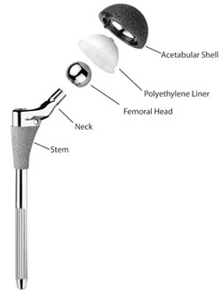
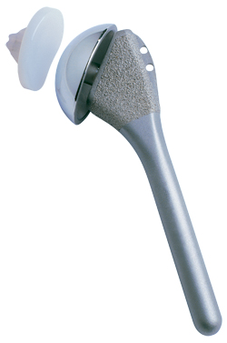
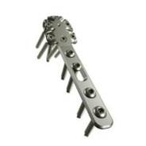
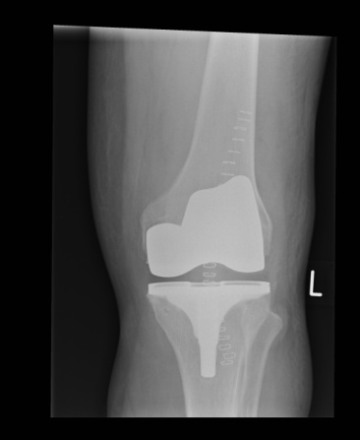
A worked example
All Wales Orthopaedic Implants Programme

Slide 19
Establish Category Goals
Where we are…
Where we want to be
Industry confused as to which is the chosen supply route, NHS SC, Wales, HB specific.
Inconsistent pricing across Health Boards
Debate is contract not price and service focussed
Clinicians not engaged and not cost focussed
Significant spend across Wales not covered by a compliant contract
Poor quality data in Oracle preventing accurate analysis of spend and trends
Many procurement teams having to be involved in pricing
Surgeon choice is final
Single co-ordinated portal to access business in Wales
Structured pricing allowing for further savings as strategy unfolds
Clinicians fully aware of the cost impact of their product selection
Multi-lot framework, reducing bureaucracy and allowing for commitment where available
Products coded consistently and categorised within a common structure
A centrally managed catalogue
Clinical evidence built into the system and available to all

Slide 20
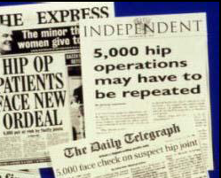
Category
Characteristics
  Scope of the category to be covered i.e. What is included in this Category group? Category characteristics, breakdown into subgroups.
  Understand the history.

Slide 21






What is the strategic direction of stakeholders?

Slide 22
Product categorisation
Orthopaedics
£37.8m
Joint Replacement
£20.2m
Hips
£9.6m
Knees
£9.64m
Extremities
£882k
NJR Fees
£53k
Trauma
£5.67m
Internal fixation
£4.9m
External fixation
£273k
Spinal
£3.2m
Instrumentation
£4.92m
Instruments & consumables
£2.94m
Loan kits
£1.98m
Arthroscopy
£3.48m
Other
£399k
Carriage
£179k
Maintenance & Repair
£13k
Other
£207k
Maxillo Facial
£500k
Spinal
£2.6m
Biologics
£589k

Slide 23
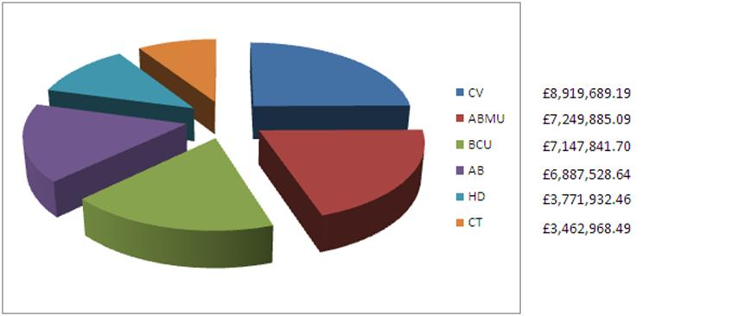
Who spends the money?
Health Board share of £37.4m expenditure

Slide 24
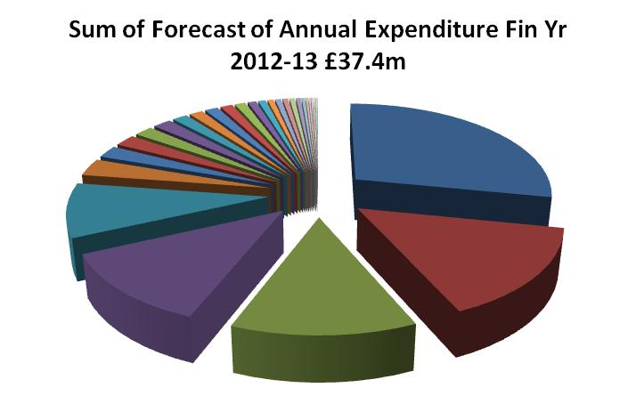
Who receives the money?

Slide 25
Summary
Transparent, structured pricing and data derived from a framework agreement, allowing for informed transformation with each of the key stakeholder groups facilitating the move from Chaos to Control
Targets
10% savings per annum
Switch effort from contract to spend focus
Establish centre of excellence
Supplier drivers
High value of annual spend
Surgeon focussed engagement model
Intentional Confusion
Trojan horse sales techniques
Levers
Multi supplier Framework
Clinically driven negotiation
Transparency
Benchmarking
Volume/value commitment
Rationalisation
Bulk buys
Logistics
Stakeholders
Surgeons
Suppliers
Finance
Welsh Gov
Procurement
Theatre nurses
Theatre Managers
Market
£38m pa
‘000 of products
Multinational suppliers
High on political agenda
Barriers
Access to and quality of data was poor. Health Boards had their own plans. Surgeons had their own plans. No ownership. 3rd Party orgs in market. No single view of category.

Slide 26

So what does that mean for suppliers?
Will provide you with a clear understanding as to who your customer is and best route to market
Provide visibility of pressures and opportunities relevant to your market area
Provide reassurance that the buyers you interact with ‘speak your language’
Will provide greater transparency of your position in each market
Will make the NHS in Wales easier to deal with
Win
Win

