Slide 1
Pharmacy, Appliances & Dressings (PAD)
Matthew Perrott
Senior Category Manager

Slide 2
Objectives
Explain the PAD team
Category Team overview
Governance & stakeholders
What’s on the horizon
How you can be involved

Slide 3
PAD by numbers
48 existing contracts
11 new contract areas under review for 2014/15
£134m Annual portfolio value
18 staff
10 Key Stakeholder / operational groups
4 Category teams

Slide 4
Overview of the PAD team
Head of Sourcing
Bethan Jenkins
Senior Category Manager
Matthew Perrott
Medicines Acute
Medicines Homecare
Homecare Services
Appliances and Dressings
Pharmacy

Slide 5
Medicines Acute
Managed by Tracey Prothero
What’s in the category
24 All Wales, Secondary Care Drugs contracts
£86.8m annual contract value
Proprietary Drugs
Generic Drugs
Vaccines

Slide 6
Governance Structure
Governance Structure
Welsh Government
Health Boards
All Wales Drugs Contracting Committee
link into the other Home nations
Quality –
Working with industry;
Association British Pharmaceutical Industry (ABPI)
British Generic Manufacturers Association (BGMA).

Slide 7
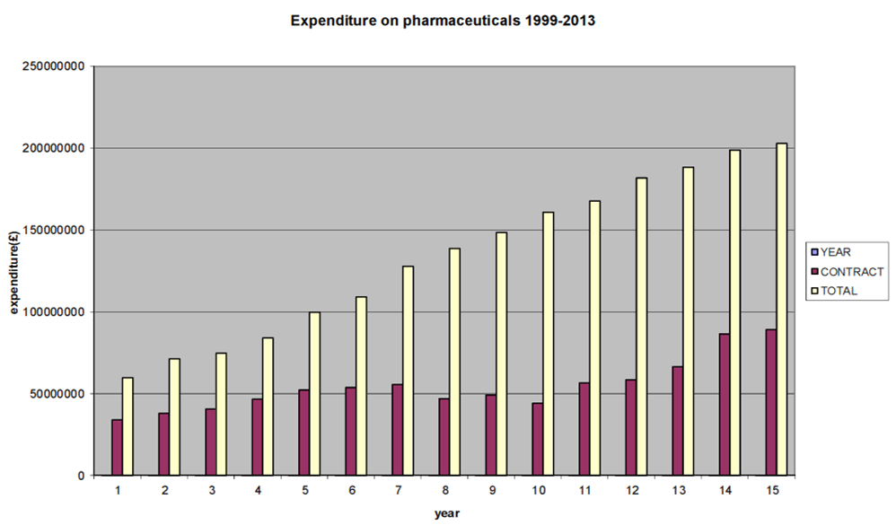
What’s on the horizon?
Expenditure on pharmaceuticals

Slide 8
What’s on the horizon?
Drugs coming off patent
Licensed / Unlicensed drugs
New drugs – Oncology
Therapeutic tendering

Slide 9
Medicines Homecare
Managed by Nigel Williams
New area of activity to be undertaken following recommendations of Hackett report
20,000 patients currently receiving homecare
Spend in excess of £60m
Move to centralised procurement model
UK scenario

Slide 10
Medicines Homecare
New area of activity to be undertaken following report, “Towards a Vision for the Future” by Mark Hackett
Homecare Handbook
Industry standards
Procurement Toolkit
The aims are;
Governance & Compliance
Enhanced patient experience
Develop competitive & stable supply market Financial benefits
Working in Wales through;
Welsh Government Minister for Health
All Wales Medicines Homecare Committee

Slide 11
What’s on the horizon?
Therapeutic tendering
New contracts to be undertaken in next 12 months
Oncology (advertised within next few weeks)
Rheumatology
HIV treatment
Fertility
New opportunities for emerging providers / diversification

Slide 12
Homecare Services
Managed by Gill Bailey
£15m per annum
Highly complex services
Improved patient care & support
Innovation drivers
Limited competition
Reducing wastage
WP10 Prescription pricing
Partnership service delivery
re-evaluate the traditional approach

Slide 13
Homecare Services
What’s in the category?
All Wales & regional contracts,
Delivering services to patients in their own home
Contract areas include:
Enteral feeding
Home Parenteral feeding
Stoma care
Management of Incontinence
Home Oxygen Therapy

Slide 14
Appliances & Dressings
Managed by Thomas Dumbleton & Janet Smith
What’s in the category
Dressings – working with Surgical Dressing Manufacturers Association
Wound Management
Absorbents
Orthotics
Stock & Bespoke
Appliances
From Wigs to Insoles
Wheelchairs
Community Equipment
Notes:
Need to mention

Slide 15
Appliances & Dressings
Wide range of Stakeholder Groups ;
Orthotics Sub Group
Wound Management Group
What the Groups do
Spec writing
Tender Evaluation
Contract management
Working with industry leads to include
Trade Associations
Home Nations
SMTL
Standard advisory panels

Slide 16
Appliances & Dressings
What’s on the Horizon for 2014/15?
Wound Management
Acute
Community
Orthotics bespoke products
Orthotics Services
Low Vision Service
Wheelchair Provisions
Dental Consumables
Absorbents

Slide 17
How can you be involved?
All contracts advertised on Sell-2-Wales
OJEU notices on e-Tender Wales (Bravo) & TED
No supplier lists
Lotting strategies
Quality First
PharmaQC
SMTL
End User testing
Pass / Fail quality requirements
Value for money
E-auctions

Slide 18
What does this mean for PAD?
Robust supplier relationship management to allow
growth and innovation in the delivery of Healthcare
Continuous improvement is a key part of the Category approach
We cant work in isolation
We need to use the industry and suppliers
to help build a value network
Notes:
Smtl for lab testing to compliance & spec design in line with market & industry standards.

