Slide 1
Mark Roscrow Director of Procurement Services, NWSSP
NHS Wales Shared Services
30th June 2014
MediWales
NHS Procurement Event

Slide 2
NHS Wales Shared Services
Procurement Services
Category Management
Prudent Healthcare/Innovation

Slide 3
NHS Wales Shared Service Partnership (NWSSP)

Slide 4
Motivation & Organisational fit
SSP was founded on the potential to develop further benefits to the wider public sector.

Slide 5
NWSSP Shared Services - Stats
Overall | Legal & Risk | Employment | Facilities
1,3800 staff | 1,900 Clinical Negligence Claims | 77,824 staff paid each month and 6,000 staff paid per week | £900m of contracts let though ‘Designed for Life’
£200m budget inc Welsh Risk Pool | 590 personal injury claims | 99.3% payroll accuracy | £5m saved in procurement costs
50+ sites | 170 Inquests | 270,000 expenses claims processed | £1.5m savings on 50 leases negotiated per year
95% expenditure of NHS Wales processed | 706 general advisory cases | 10,000 CRB checks processed | 20,000 hits on Estates and Engineering website

Slide 6
NWSSP Shared Services - Stats
Procurement Services | Primary Care Services | Workforce Education Development Services | Audit and Assurance Services
546,000 Orders processed | £1.4bn transactions processed | Tuition fees for 6,000 students | 6,000+ audit days
£932m order processed | 74m prescription items pa | Bursary Assessment for NHS students | 3 new audit appointments
2,800 all Wales Contracts | 36m prescriptions pa
1.3m Invoices processed | 1.2m ophthalmic claims
32.8m items issued for Stores | 7,000 dental claims
4,500 customers in Wales | 400k medical record transfers

Slide 7
Governance Arrangements for SSP
Velindre NHS Trust Legal Framework
Chair
Shared Services Committee
Director of Shared Services
WOD
WEDS
Counter Fraud
Audit and Assurance
Primary Care
Procurement Services
Facilities Services
Employment Services
Legal & Risk
Underpinned by Velindre NHS Trust - using the overarching Velindre NHS Trust policy and assurance framework including audit committee arrangements.

Slide 8
Procurement Services

Slide 9
So what is Procurement Services all about then?
Some numbers first
Budget for 517 staff (£12.6m)
Non Pay - £2m
Contract Value of over £500m
Special WG Projects £100m
Stores service with an annual trading value of £36.6m and over 4500 customer
NHS expenditure on goods & services (influenceable spend) 12/13 - £800m

Slide 10
P2P and Links to Procedures

Slide 11
Procurement Services
Structure 2014
NWSSP Director
Finance Support (Link into SSP Corp Finance team)
NWSSP Director - Procurement Services
Corporate (PA/Quality/IT)
Deputy Director PS/Head of NHS Engagement
Heads of Sourcing
Head of Supply Chain
Head of Accounts Payable
Heads of Procurement
Medical/ Clinical Team
Non-Medical/ Maintenance Team
Projects/ Capital Team
Pharmacy, Appliances & Home Services Team
Accounts Payable Teams
E-Enablement Team
Local Procurement Teams
South West Region
South East Region
North Region

Slide 12
Procurement Services Locations
WALES
Procurement Locations
1. Betsi Cadwaladr University LHB/WAST | 3 Sites
2. Powys LHB | 0 Sites
3. Hywel Dda LHB | 5 Sites
4. Abertawe Bro Morgannwg University LHB | 5 Sites
5. Cwm Taf LHB | 3 Site
6. Cardiff & Vale University LHB | 2 Site
7. Aneurin Bevan LHB | 2 Sites
8. Velindre NHS Trust/Public Health Wales | 3 Sites
1
2
3
4
5
7
6
8

Slide 13
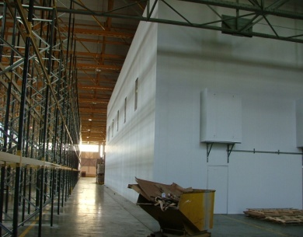
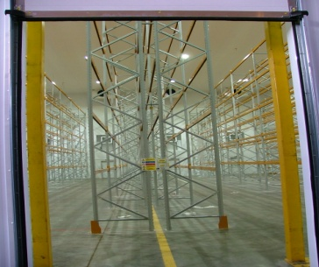
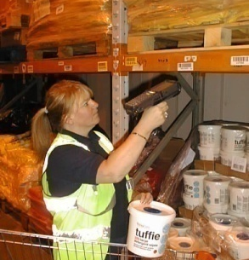
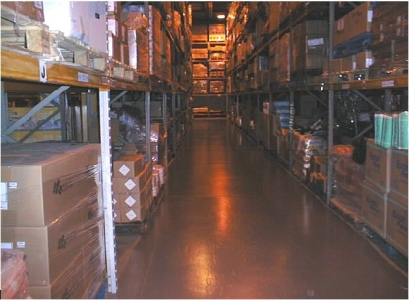
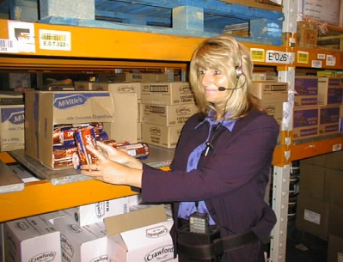
Supply Chain
Storage and Distribution Division
Locations:-
Main Stores
Bridgend, Denbigh and Cwmbran
R&D Locations
Flu Resilience location for WAG
All operating using Oracle
Main Role
Storage and Delivery Service across All NHS Sites
Including Cervical Screening Service to Hospital GP Clinics etc

Slide 14
Sourcing
Contracting part of Procurement
1000’s of Contracts
£500m approx value
Covers
Medical/Clinical
Non Medical/Maintenance
Projects/Capital
Pharmacy, Appliances, Drugs and Community (PADAC)

Slide 16
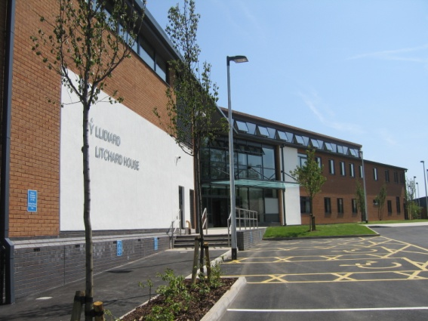
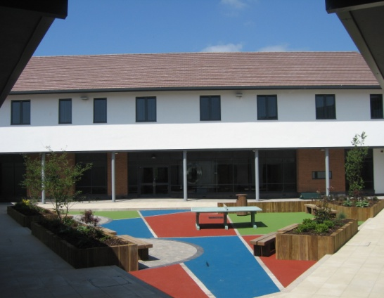
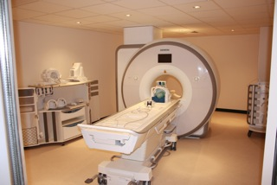
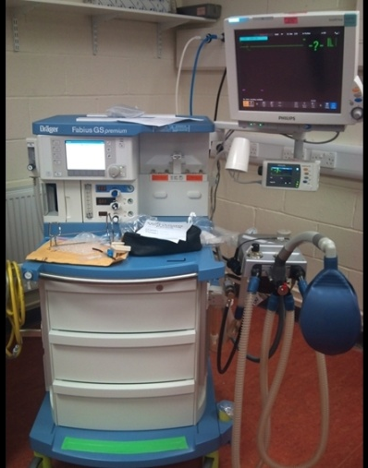
Capital Team
Focus on Equipment for
New builds or refurbishments
Discretionary Capital spend
Onsite commissioning
Disposal of surplus kit
Need of development
Limited IT investments

Slide 17
Purchasing
Locations across Wales
All utilise Oracle system
Catalogue request self generate through approval process
Buyers action non catalogue requests
(aim to reduce this significantly)
Key focus going forward – base for Procurement Managers

Slide 18
Payments
Locations across Wales
Staff numbers vary
Some integration with Purchasing Teams
Variable use of technology
Key focus for modernisation
Exchange Wales – Back office integration
Scanning Solution

Slide 19
E-Enablement
Catalogue Loading
IT Training
Oracle Helpdesk
Reporting
e-Invoices

Slide 20
Category Management

Slide 21
Heads of Sourcing
Andrew Smallwood - Medical/Clinical
Vacancy - Non Medical/Maintenance
Nic Cowley - Projects/Capital
Bethan Jenkins - Pharmacy, Appliances, Drugs and Community (PADAC)

Slide 22
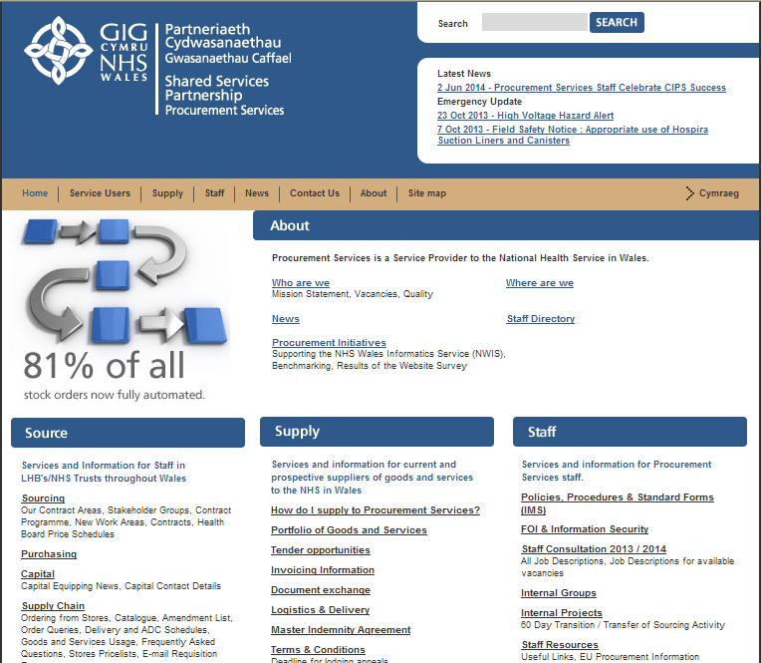
Procurement Services website

Slide 23
Prudent Healthcare/Innovation

Slide 24
Vision for the Future
Strategic Governance - Establish Clinical Consumable Board
(All Wales – similar to Pharmaceuticals)
WHO? Clinical/Medical Leadership
Robust reporting arrangements back into CEO/DOFs ?
Contracts let once only for Wales – One Wales approach, and robust understanding and reporting for any deviation
(NHS England approach - ? HTA with HB/Trusts)
A Contracts Programme linked to the Savings Delivery Plan
Products and Services that deliver value for money and represent acceptable quality
Clearly understood system for designing contracts, partnered between HB/Trusts and NWSSP

Slide 25
Vision for the Future
Products and Services that provide a safe Clinical outcome to meet the patients needs
Evidence that price and quality benchmarking has been undertaken and is robust within ‘the system’.
A Service that reflects the Welsh Government Procurement Statement – ‘A route to consider Innovative Products’ in particular the Welsh Economy and Community Benefits

Slide 26
Objective/Action Plan
Initially set up a T&F Excellence Group to determine the scope and activity in order to establish the Clinical Consumable Board (similar to Pharmaceuticals)
Establish a robust Governance Structure with links to existing groups including CE’s/MD/DoF’s/SSC and feeds back into HB/Trusts
Consider project management role to move through transition into implementation of new approach
Review resources within SMTL & other appropriate teams to support the work programme
Establish a culture of “adopt or justify”
Align the Work Programme to the Contract Programme
Provide a route for innovative products to gain consideration for use in NHS Wales
Link into other appropriate resources i.e. Life Sciences
Agree timeframes to change

Slide 27
Procurement What Works – What Doesn’t
Cost of freedom of choice
Example 1: Where leadership is needed to bring about clinical change and release value!
Laryngoscope Blades, Handles & associated consumables is due to be awarded for 1st March start with £50k savings. However, if Health Boards migrate to lower cost alternatives on the framework then the savings rise to £200,000
Comment made by Health Minister when signing the award paper was:
“Collectively we could save £150,000 by adopting the best value products in this contract. It is just one example of the prudent healthcare approach in practice. While comparatively small at each LHB level it amounts to a sum significant sum collectively”.

Slide 28
Group to Lead Change
CMO
Directors of Finance and Procurement
Health Board/Trust Medical Directors
Chief Executive
Procurement Services

Slide 29
Ingredients for Success
Clear vision for the future
Top level support for the change
Leadership to drive the change
Structure and resources to move forward
Clear timescale for change

Slide 30
Getting Innovation into the NHS
Wales
England

Slide 31
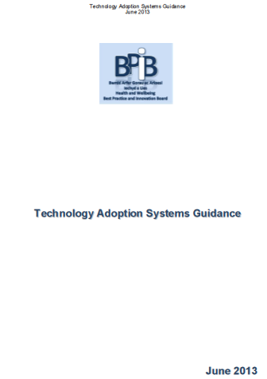
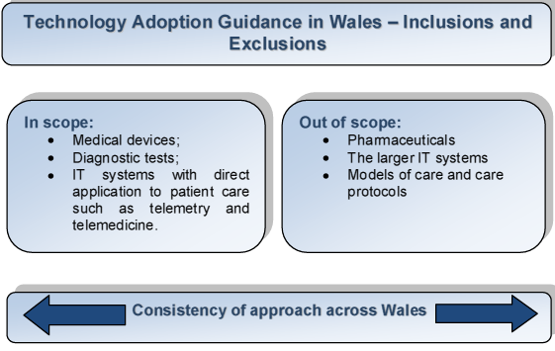
Technology Adoption Systems
Scope and Definitions

Slide 32
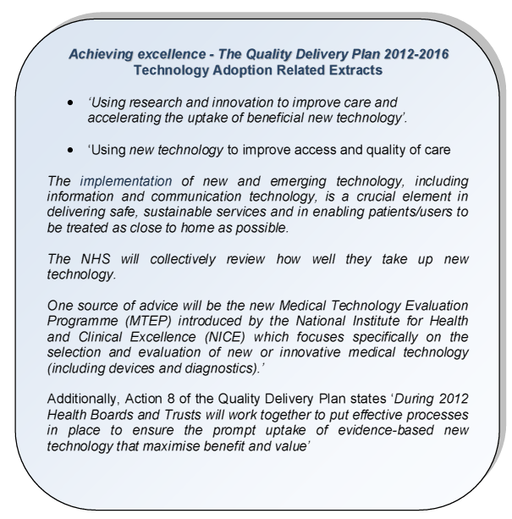
Technology Adoption Systems
The Policy Context

Slide 33
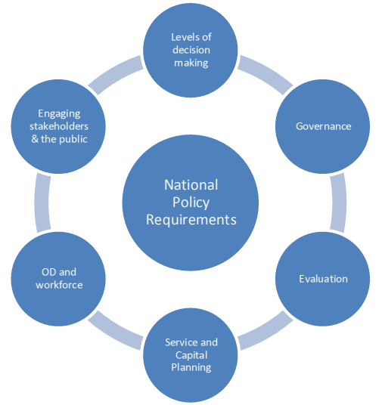
Technology Adoption Systems
Key System Requirements

Slide 34
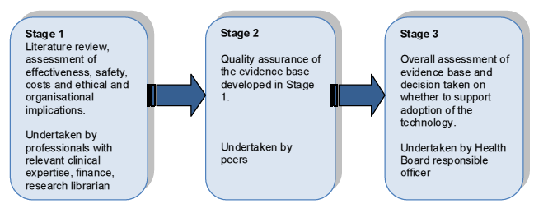
Technology Adoption Systems
The mini-HTA process

Slide 35
The Health Cloud Project
Welsh Health Cloud technology to bring healthcare benefits to UK NHS
A new £600K project has brought Swansea University researchers and Welsh eHealth companies together, to develop cloud computing technology which will deliver significant long-term benefits both to the UK NHS and the Welsh economy
“A tremendous amount of innovative research is carried out in Welsh universities which Welsh businesses can tap into and help commercialise, and I am pleased our A4B programme is actively supporting new opportunities for e Health companies.”

Slide 36
AHSN - England

