Slide 1

When Tenders Go Bad!
Essential Requirements and Common Mistakes

Slide 2
Objectives
Brief overview of a typical OJEU tender process
Highlight e-systems used by NHS Wales
Discuss typical mistakes made by prospective suppliers and how to avoid them including:
  Responses to Advertisements
  Pre-Qualification Questionnaire (PQQ) submissions
  Invitation To Tender (ITT) submissions
  Participation in Reverse Electronic Auctions

Slide 3
Tendering Process
Ongoing
Management
Planning
Contract
Start
Advert
Contract
Approval/Award
Supplier
Selection
(PQQ)
Tender Evaluation
Tenders
(ITT)

Slide 4
Help Us to Help You
We don’t want to exclude you!
But we must evaluate all suppliers equally
Silly mistakes could:
  Cost you the business
  Waste our time
  Waste the effort taken to submit a tender

Slide 5
Key Principles
Read all information provided
Ensure you provide:
  whatever we have requested…
  in the format it is requested…
  by the deadline that is requested.
If you do not understand/are unsure, ask questions!

Slide 6
Adverts

Slide 7
Advertisements – Sell2Wales
www.sell2wales.gov.uk
No Supplier Lists
Business opportunities advertised
View advertisements on Sell2Wales website
Adverts may also be visible via OJEU and in etenderwales depending on procurement route

Slide 8

Sell2Wales

Slide 9
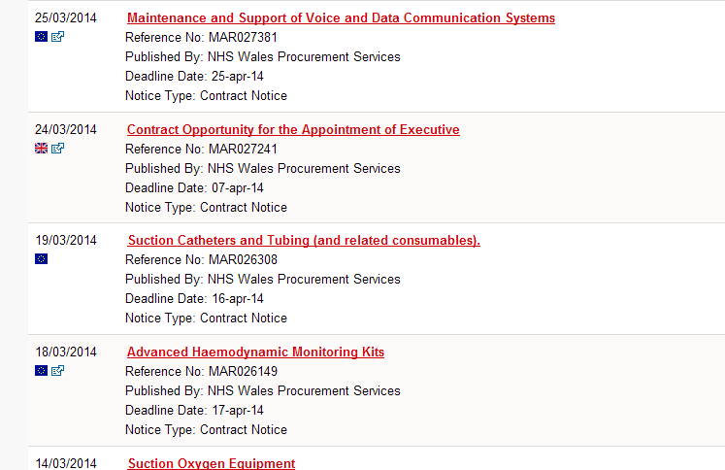
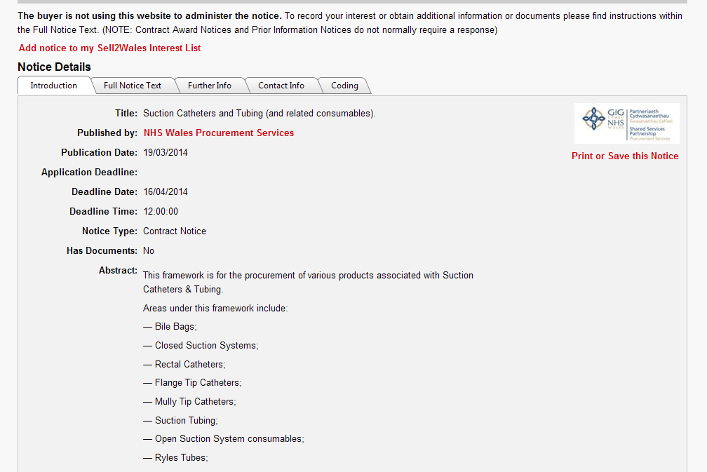
Select the advert that interests you…
Read full details of notice
taking note of deadline to respond

Slide 10
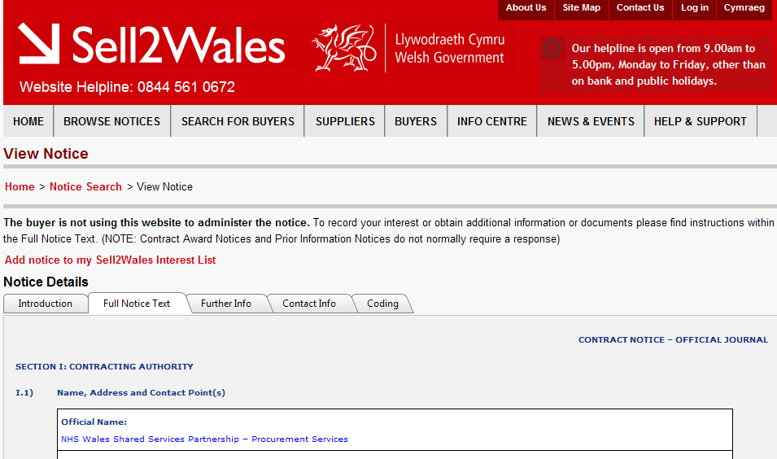
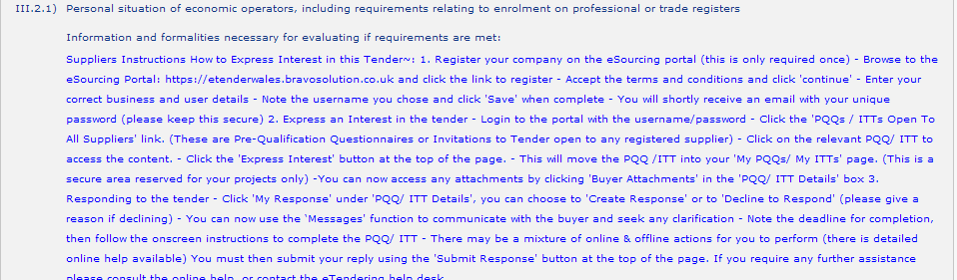
Read full notice text
Check how to express
interest

Slide 11
Expressing Interest
Might involve:
  Signing up to receive PQQ/ITT at later date
  Completing PQQ immediately (Restricted Procedure)
  Completing ITT immediately (Open Procedure)
Advert will explain which of the above options is being used and how to express interest in the business.
Email not normally sufficient to express interest.

Slide 12
PQQs & ITTs

Slide 13
PQQs & ITTs
Different stages of the process, but similar issues apply
Bravo portal (exchangewales) used
Ensures responses are not viewed before deadline
Ensures late responses are not accepted
Provides standard form for completion

Slide 14
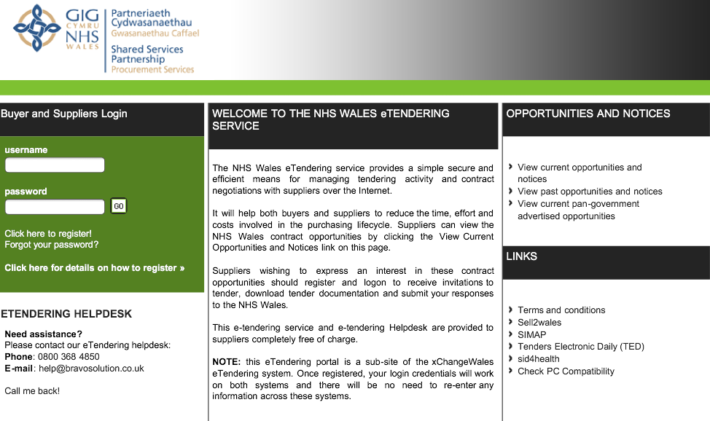
Etenderwales
http://etenderwales.bravosolution.co.uk/nhs

Slide 15
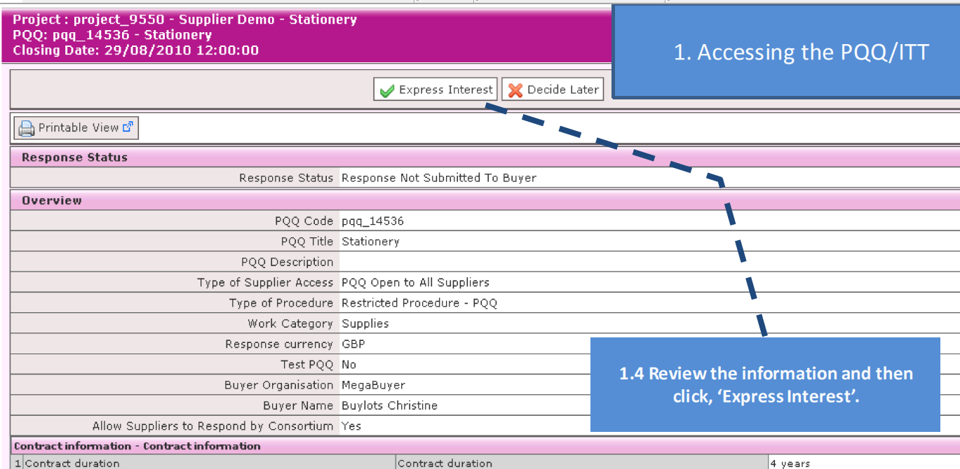
Accessing the PQQ/ITT
Register your company (if you haven’t already)
Select the relevant link e.g.“ITTs Open to All Suppliers”
Select the contract and “express interest”
Complete in “My PQQs” or “My ITTs”

Slide 16
Structure of PQQ/ITT
Qualification Envelope
- For submission of info about your company
Technical Envelope
- For return of key information regarding the ITT
Commercial Envelope
- Pricing and product information
Attachments
- Further info, guidance and forms to submit

Slide 17
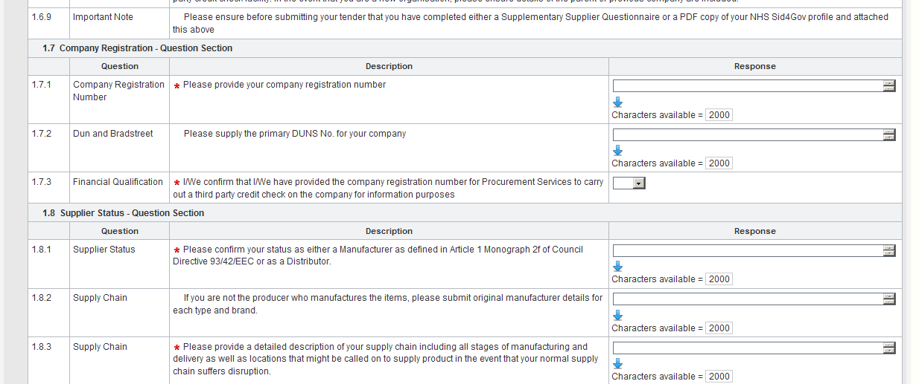
Etenderwales – ITT/PQQ

Slide 18
Submitting a PQQ/ITT
Read the instructions, answer all questions and give us the information we have asked for
Save regularly - 15mins inactivity “time out”
Submit all queries via the Bravo messaging function – responses will be shared with all bidders.
Do not leave it until the last minute to respond
Don’t forget to “Submit Response” once complete!
Technical Issues? Contact Bravo Helpdesk
0800 368 4850 or use “Help For Suppliers” button

Slide 19
Common Mistakes
Read all information carefully to understand how your response will be treated/assessed
Don’t forget about attachments
Ensure all ext. profiles are current e.g. Sid4Gov, SQUID
Ensure insurance policies etc are current
DO NOT send your tender via Post/Email

Slide 20
References
Read requirements of references – are yours appropriate for our needs?
Can your references be contacted/verified?
Have you asked your reference if they are happy to respond?
How many references have we asked for?

Slide 21
As Dead as a Deadline
Late responses CANNOT be accepted
Consider how much time your response will take
Ask questions as early as possible
Don’t leave it until the last minute!

Slide 22
Evaluation Process

Slide 23
Evaluation Process
A combination of:
  Mandatory requirements (terms and conditions)
  Criteria for the quality of products/services required
  Financial evaluation
The evaluation might include:
  Bench top evaluations of products
  Laboratory testing of products
  Evaluations in clinical setting
  Supporting documentation
  Trial run or pilot study

Slide 24
Specifications
Outline how and when your submission will be evaluated during the tender process
Don’t assume your product will fit just because you’re supplying somewhere already!
Read specification documents carefully
Clarify anything you don’t understand
Observe any limits on the number of submissions you can make
Ensure your submissions comply with the specification

Slide 25
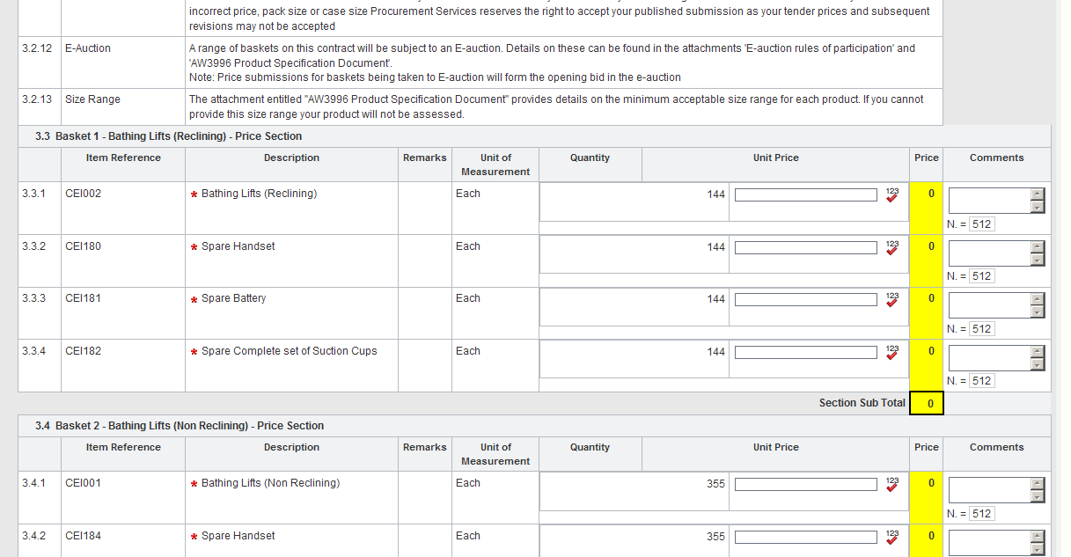
Financial Evaluation

Slide 26
Financial Evaluation
Read lot structure carefully
If required, ensure a price is offered for all items in a lot or you may be eliminated from the lot
Price according to the Unit of Measure given, e.g. Each
Include your references/product codes
Read specification – price may have to include additional elements e.g. spares, warranty, delivery
Check whether the price submitted is your final offer or an initial bid in a lot that will be e-auctioned.

Slide 27
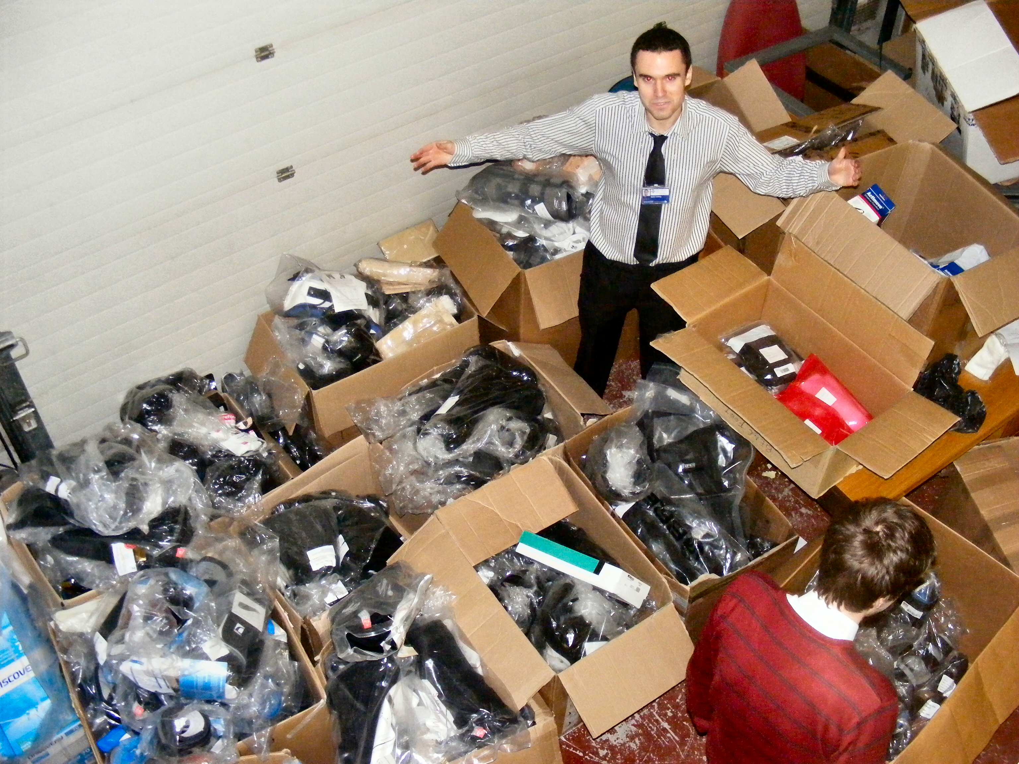
Samples

Slide 28
Why do we ask for samples?
We need to know what we are adding to contract
To facilitate evaluations with clinical specialists
To facilitate Laboratory Testing
Demonstrates suppliers’ capability to provide

Slide 29
Timescales for Samples
Are often different to ITT timescales
Make sure samples are delivered within the requested timescales – don’t miss your chance to be considered!
Contracts with multiple evaluation stages
Send the samples to the right place!
There are no bonus points for extra samples

Slide 30
Preparation of Samples
Read the Sample Requirements carefully
Labelling of Samples
Production samples, not prototypes/demo stock
Include usual packaging and instructions
Delegate sample preparation to someone who will take it seriously

Slide 31
E-Auctions

Slide 32
E-Auctions
May be used as the final stage of the process
Only suppliers that are acceptable in terms of quality can participate
Allows suppliers to reduce initial prices to improve financial score
The winner takes it all!

Slide 33
Typical Settings
ITT submissions are entered by Procurement as initial bids
Auction runs for an initial period (often 30 mins)
Auction timer resets during final 5 minutes – no need to wait until the last second to bid!
If bids are equal, the earliest bidder is ranked highest

Slide 34
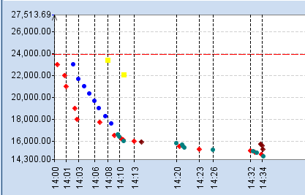
Etenderwales – E-Auctions
You will see:
  Your rank
  Your bid
But not:
  The winning price
  How many suppliers
  Who you are bidding against

Slide 35
System Error
Ensure you have the right software installed
Don’t change all the computers in your organisation the day before an e-auction event!
Contingency if connection fails
Take advantage of Dummy E-auctions

Slide 36
User Error
Use the bid sheets to calculate your bids
Determine the price you are prepared to offer in advance – you won’t have time during the auction!
Pay attention to minimum bid decrements and auction settings
Don’t forget to return your bid sheets after the auction ends – even if you haven’t won

Slide 37

Golden Rules
Read the advert first
Check all your documents
If you don’t know, ask!
Don’t leave it until the last minute

Slide 38
Thank you for Listening!
Any Questions..?

