Slide 1
Sharp – Working through COVID - 19
June 23rd, 2020

Slide 2
The Health of our employees and their families is the Absolute Priority
Initial steps:
Pandemic Plans activated
COVID Action Taskforce (CAT)created
Daily COVID site management meetings
Daily CAT calls – all sharp sites
Daily Employee Communication Bulletins
Social distancing, WFH, Risk assessments, supporting those with underlying health condition, childcare etc.
All initial measures put in place to protect our employees whilst still being able to remain open for business.
2 | UDG Healthcare plc
Notes:
Pandemic Plan – worked through 5 risk levels from low to high – action items within step – level 5, where we are still working at – no essential travel, no visits to the sites, work from home where you can work from home (IT really came to the front in terms of readiness – zoom for everyone, issuing out IT equipment, tokens to access network, increased internet security etc.

Slide 3
The Health of our employees and their families is the Absolute Priority
Business impact was felt when the first positive case was announced on March 26th. The following week was dedicated to the organization focusing on how to deploy enhanced safety measures. As of April 3rd the organization began to pivot towards balancing safety enhancement with beginning the business recovery. By April 7th the recovery plan was in place and being executed. No patients were impacted!
Examples of Safety Measures:
Enhanced cleaning efforts
All temperatures are checked as employees enter the buildings within US/EU sites
Staggered Shifts and break times.
Adjusted employee entrance and exit flow at some of our sites
Reduced crew sizes in Biotechand Specialty rooms
Enhanced PPE protocols e.g. face shields, masks, ramped up social distancing measures in place around the sites
Continue to have employees working from home where they are able to.
Remain engaged with employees who chose to stay home to understand their thinking - Survey
Business Modifications:
Sales team worked closely with customers to ensure proper prioritization during recovery period
Dramatically reduced Capex spend in Q3 to maximize short term cash position
Continued to focus on Customer Collection efforts(hitting a historical best)
3 | UDG Healthcare plc

Slide 4
Important Learnings:
Site Covid Taskforce
Employee reporting system specifically for potential Covid cases – 24/7
Process created to handle a positive case at your site.
Communication is key – daily or weekly updates, or as and when things change with the site. They must be clear and consistent.
Flexible with work i.e. hours, location – everyone will have their own individual situations – listen to them.
Visuals, Visuals, Visuals everywhere at your site – management at all levels keep on top of social distancing.
Right now, in a time of constant change, is probably the hardest time – people are experiencing uncertainty
Training on day one of the return – social distancing measures, new site rules (visitor declaration forms), changes to the site layout etc.
Keep tight controls over who is accessing the site – Sharp sites have to gain approval from GM/HR

Slide 5
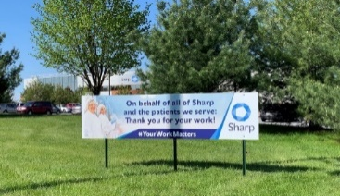
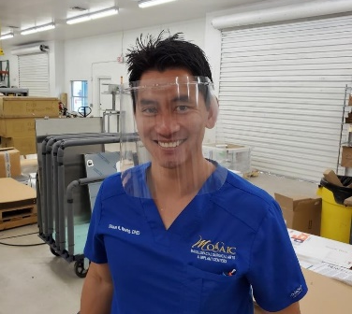
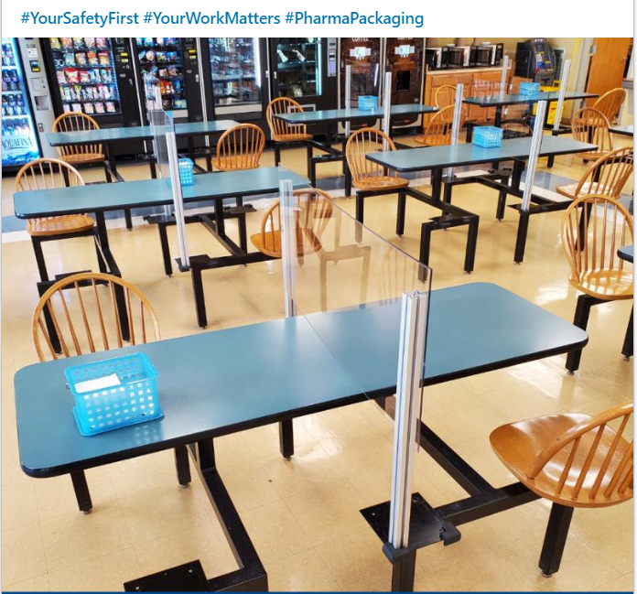
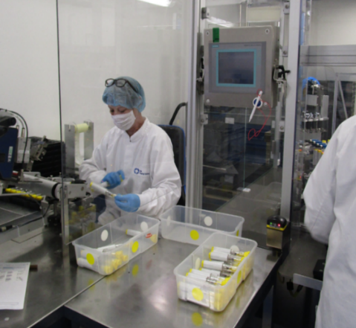
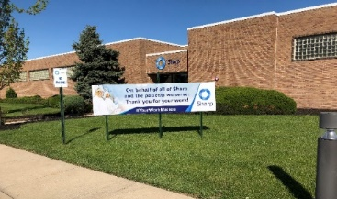
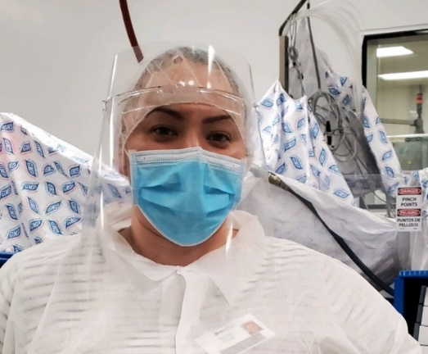
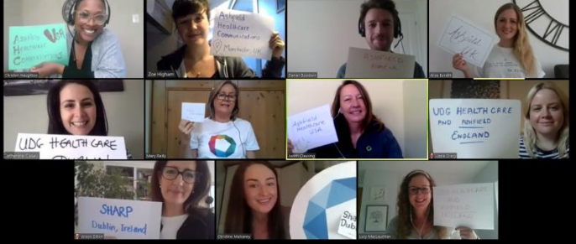
Protecting and valuing our employees…
Conshohocken
Hamont-Achel
Sharp offers thanks to all our own frontline workers
Sharp Conshohocken donated raw material for the manufacture of face shields for local frontline workers
As we adjust to our new reality, we found new ways of working together, while staying apart to stay safe
Employee support initiatives including: WellSpace, Sanctus, Attentive Health Coach and CLARIFI financial support services
Allentown
Hamont-Achel

Slide 6
While ensuring supply for patients…
#OurWorkMatters
Sharp Clinical launch new service offering in collaboration with Ashfield for sponsors to support patients in their homes
Sharp Packaging US have successfully supported the launch of six new products - in some cases ahead of schedule - despite strict adherence to the necessary COVID-19 rules & restrictions
Sharp Clinical have 6 active COVID-19 related projects, and have quoted on >35 treatment or vaccine projects most related to respiratory therapies.

Slide 7
Co n clusio n &
FY20 Outlook

